Slide 1
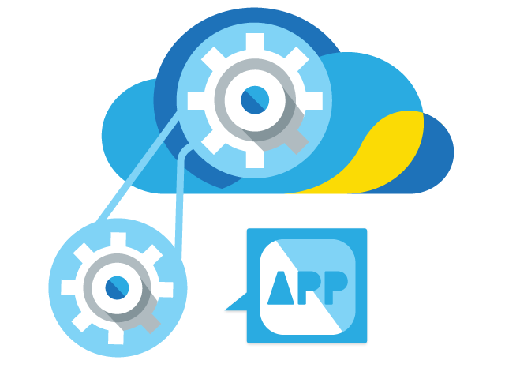


APPLICATION PROGRAMMING INTERFACE

Slide 2

ANIMATION
Animation is the process of making the illusion of motion and change by means of the rapid display of a sequence of static images that minimally differ from each other.

Slide 3
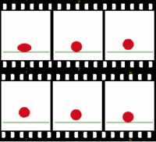

Slide 4
